Slide 1

MAJOR PROJECT (SQL & POWER BI)
SURE TRUST
SURE TRUST
STUDENT ENROLLMENT ANALYSIS
1. Mr.Sparsh Agarwal B.Tech 4th year (Civil)
2. Mr.Kontham Gangadhar B.Tech 4th year (Data Science)
3. Mr.Patnam Naveen B.Tech 4th year (Data Science)
Team Leader
Team Member
Team Member
Period of the project :
DEC 2024 To Feb 2025

Slide 2

Summary:
To Analyze SURE TRUST’s student enrollment data from 2022 to 2024 to identify trends that inform strategic decision-making and support institutional growth.
Analyzing 11,721 records from 2022 to 2024, revealing a decline in enrollment over three years, while online course participation surged.
Demographic factors, such as age and geographic location, play a significant role in influencing enrollment patterns.
The "SURE TRUST STUDENT ENROLLMENT ANALYSIS" project conducted a comprehensive examination of student enrollment trends utilizing Power BI, and Python script.

Slide 3
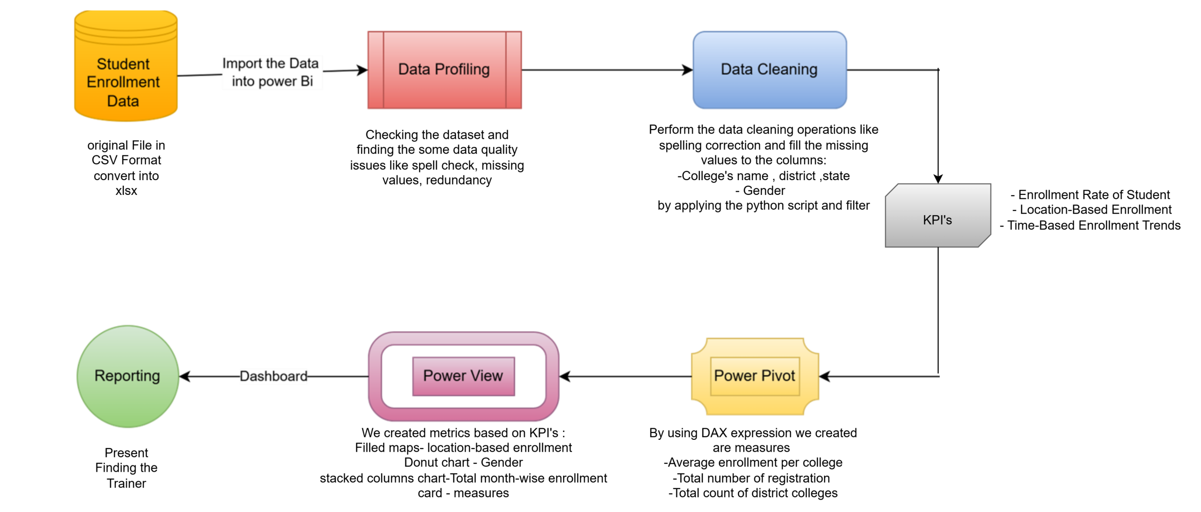
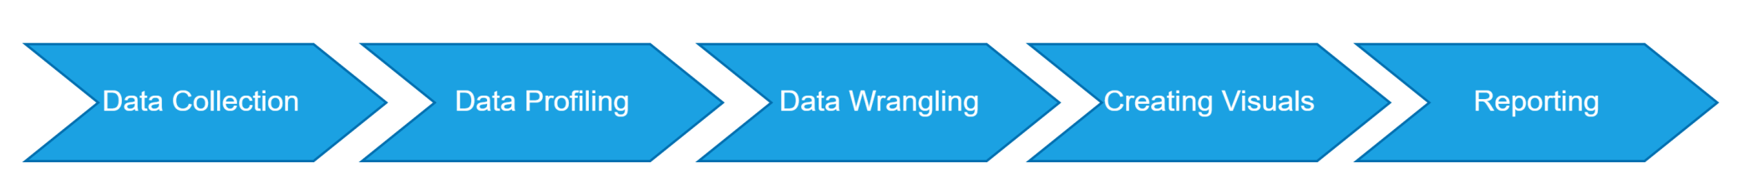
DATA FLOW DIAGRAM

Slide 4

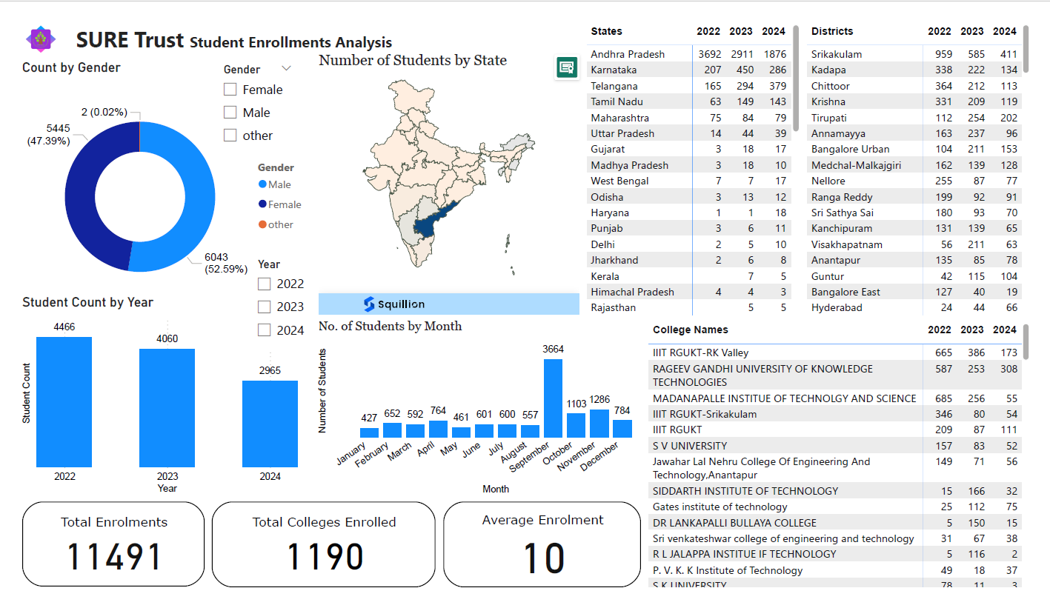
Final Project Outcome:

Slide 5
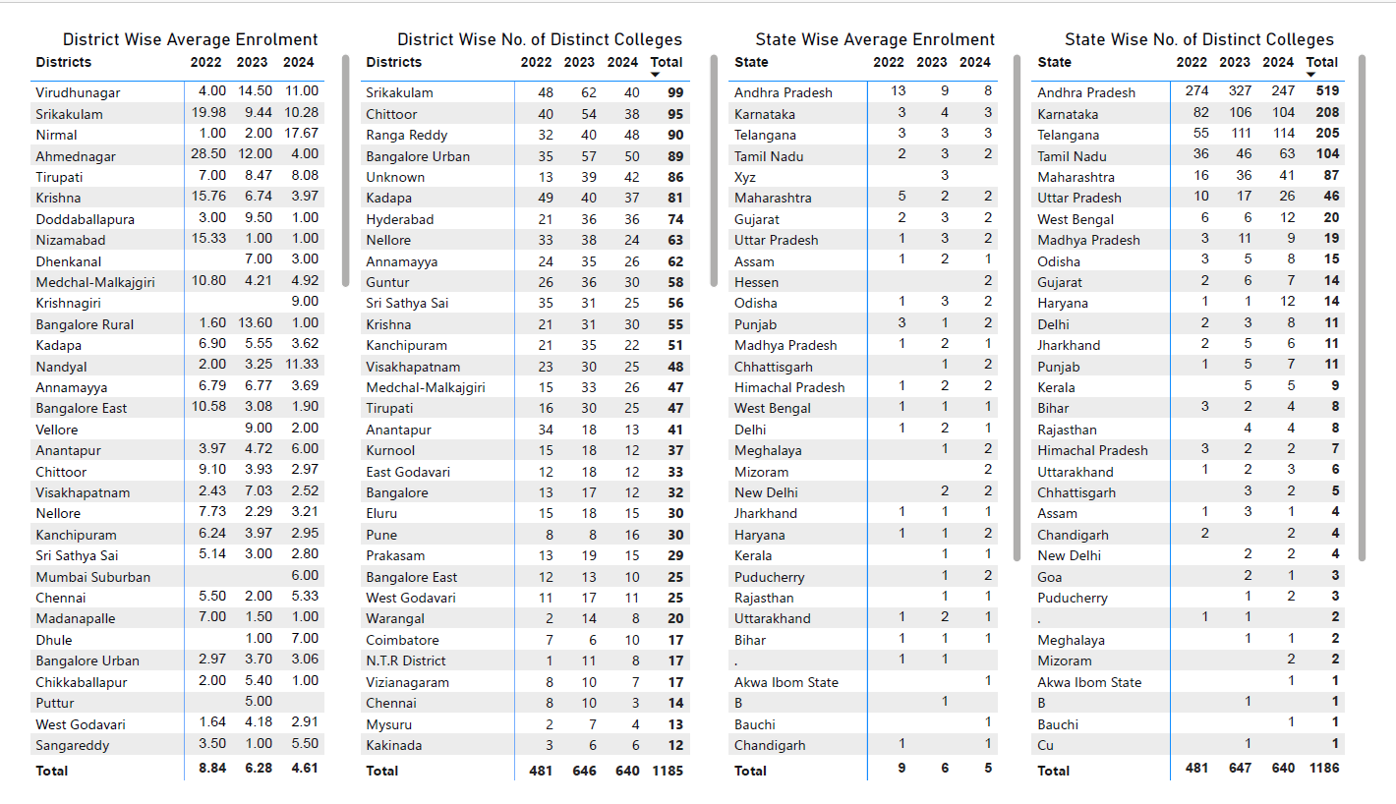

Slide 6
Experiences:
Technical Skills: Mastered Excel, Power BI, SQL, and DAX, and developed skills in data visualization and storytelling.
Team Collaboration: Learned importance of clear communication, leveraging strengths, and efficient task distribution.
Personal Growth: Team members gained valuable experience in data cleaning, modeling, and reporting, Gangadhar,Sparsh and Naveen together developing skills in collaboration and data transformation.
Best Practices: Emphasized documenting processes and methodologies for future reference, ensuring timely project completion and comprehensive reporting.

Slide 7
Take Aways:
Data Collection and Quality Issues:
Incomplete Data: Data was collected only from the website, leading to incomplete insights.
Data Quality Issues: Website submissions had errors, requiring thorough data cleaning to ensure accuracy.
Recommendations for Improvement:
Enhance Data Accuracy: Implement validation measures (e.g., dropdown menus, auto-complete features) on the website and Google Forms to minimize user errors.
Synchronize Data Collection: Collect data simultaneously from all intended sources (website, AICTE portal, Google Forms) for accurate trend analysis.

Slide 8
SURE TRUST OFFICIAL PORTAL:
To enhance data accuracy from the website, we recommend restricting free-form typing for fields such as qualification, college name, college location (place, district, and state).
Implementing validation measures—like dropdown menus and auto-complete features—can minimize user errors.
GOOGLE FORMS:
To enhance data accuracy from the Google Form, we recommend implementing validation measures by creating drop-down lists for fields such as district, state, and gender.
Additionally, the 'WhatsApp number' field should be configured to accept only 10-digit numeric entries through automated error-checking mechanisms. These enhancements will significantly reduce user input errors, streamline data collection, and minimize the need for extensive data cleaning.

Slide 9
CONCLUSION:
The enrollment decreased by 5.43% from 2022 to 2023, followed by a sharper decline of 26.81% from 2023 to 2024, resulting in an overall decrease of 30.78% from 2022 to 2024.
Enrollment trends show a nearly equal gender distribution, with Andhra Pradesh leading at 75.80% and Sikkim contributing the least.
Enrollment peaked in September with the start of new semesters and declined from January to April due to exams.
The SURE Trust website should use drop-down menus for country, state, qualification, gender, and district, limiting college names to standardized entries for better data accuracy.

